Slide 1
MICROSOFT MOVIE PRODUCTION.
Presentation done by
Paul Machau

Slide 2
Project Preview.
The project at hand is to assist Microsoft in their endeavor to enter the movie industry by creating a new movie studio. As Microsoft lacks experience in creating movies, they have tasked us with exploring the current trends and top-performing films in the box office.
The objective is to provide actionable insights to help the head of Microsoft's new movie studio decide what type of films to create.
By analyzing the current market trends and successful films, we can identify patterns and themes that resonate with audiences and translate them into potential movie concepts for Microsoft to consider. Ultimately, the goal is to help Microsoft make informed decisions that will increase their chances of creating successful and profitable films.

Slide 3


Tools used.

Slide 4
Problem statements.
Can we identify any correlation between a movie budget and its domestic and worldwide gross sales? How can microsoft new movie studio use this information to optimize its investment.
What is the relationship between a movie popularity and its box office success? Can microsoft new movie studio leverage audience preference and ratings to create more successful film
How can microsoft new movie studio use data on movie reviews and ratings? Hence identify opportunities for improving the content and increasing audience engagement in the ne microsoft movie studio.

Slide 5
Objective .
Analyse a production budget, domestic and worldwide gross and determine the correlation between the three.
Analyse a popularity and ratings movie data set to make a comparison between the two and how microsoft can us this information to analyse its data.
Analyse the movie reviews and rating find if there is any correlation between the and provide information on how microsoft can us this information to starting up a successful movie studio.

Slide 6
1.Analyse a production budget, domestic and worldwide gross and determine the correlation between the three.
As we all know that the world is moving towards modernization, people are starting to make movies of the famous books and animated films to attract more people to increase their revenue collections.
This has led to a huge increase in revenues worldwide and gave a boost to the film sector and their actors.
In this research paper, we analyse and predict how the current data leads to a gradual increase in budgets and revenue collections.

Slide 7
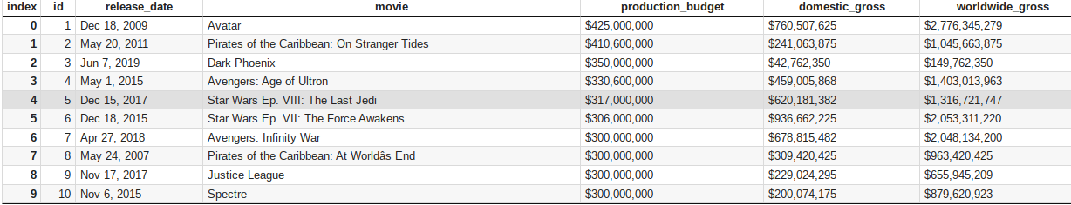
Production budget dataset
Below is a representation of part of the data set used to analyse the production budget, domestic gross and world wide gross.

Slide 8
Data analysis process
Data with thin a csv file (‘tn.movie_budget.csv) was analysed and the data was cleaned and then analysed and visuals produced and the data cleaning process involved the following steps.-
Removing duplicates
Checking for missing values
Standardize data formats .
Run a correlation analysis
Create a Heat map.

Slide 9
Analysis
Data analysis was done using python where the results did show a positive correlation between production budget, domestic gross and worldwide gross sales . where a correlation matrix was done and showed-
There is a strong positive correlation (0.748) between production budget and worldwide gross. This suggests that movies with higher production budgets tend to have higher worldwide grosses.
There is a strong positive correlation (0.939) between domestic gross and worldwide gross. This suggests that movies with higher domestic grosses tend to have higher worldwide grosses.
There is a moderate positive correlation (0.686) between production budget and domestic gross. This suggests that movies with higher production budgets tend to have higher domestic grosses, but the relationship is not as strong as the

Slide 10
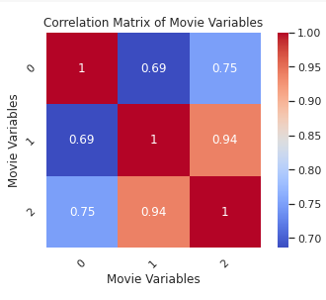
Data visualization using a Heat Map.
The diagram represents a Heat Map that shows the correlation matrices of three variables.
0 - production budget
1 - Domestic gross sales
2 - world wide gross sales.

Slide 11
2. Analyse a popularity and ratings movie data set to make a comparison between the two and how microsoft can us this information to analyse its data.
The targeted two important variable originated from different characteristics of the movies, i.e., popularity and average ratings.
Hence, we were interested in exploring the potential correlations between these two variables. the correlations between popularity and average ratings in IMDB.
As it can be seen, there is a positive correlation between these two target variables. Accordingly, as the popularity of a movie is boosted and the movie receives higher number of ratings,the average ratings provided by the users increases. This is expected phenomenon as the users typically rate what they like.

Slide 12
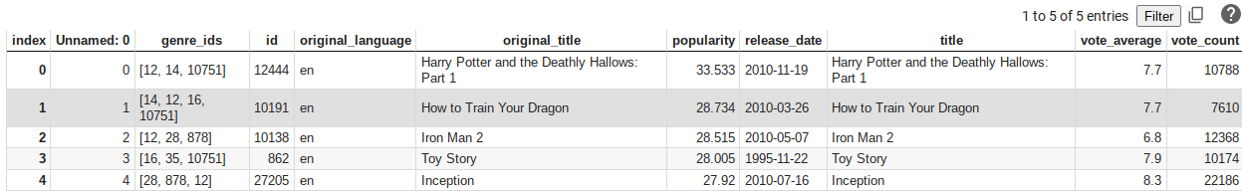
Below is a table showing dataset under csv folder('tmdb.movies.csv'
)that contained information about popularity and ratings

Slide 13
Data cleaning process
Removing duplicates
Checking for missing values
Dropping missing values within a dataset.
Convert data types
Converting date type.
Renaming the voting average column
Graphical representation of the dataframe
.

Slide 14
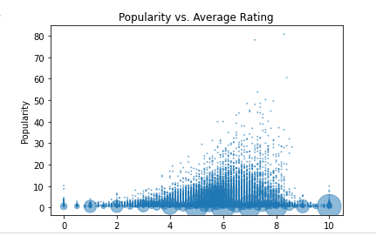
Data visualization:scatter plot

Slide 15
Analysis
The scatter plot shows the relationship between the 'average_rating' and 'popularity' columns of a dataset
The x-axis represents the average rating, while the y-axis represents the popularity.
Each point in the plot represents a unique combination of 'average_rating' and 'popularity', with the size of the point indicating the count of occurrences for that combination in the dataset.
From the plot, we can see that there is a general trend of higher popularity scores for higher average ratings, as there are more larger-sized points in the upper-right region of the plot.
However, there are also many smaller-sized points in the same region, indicating that there are still many items with high popularity scores but lower average ratings.
In addition, we can see that there are many small-sized points in the lower-left region of the plot, which suggests that there are items with lower popularity scores and lower average ratings as well.

Slide 16
Analyse the movie reviews and rating find if there is any correlation between the and provide information on how microsoft can use this information to starting up a successful movie studio.
Movie reviews are usually high before the movie is released into the cinemas but wks after the release the ratings tend to go down for some movies and review of some movies have gone contrary to gross sales of the movie.
Some movies can have bad review and make high sales leaving the critics being biased hence the correlation between reviews and ratings is negative hence the two can not be used in prediction of the data set.

Slide 17
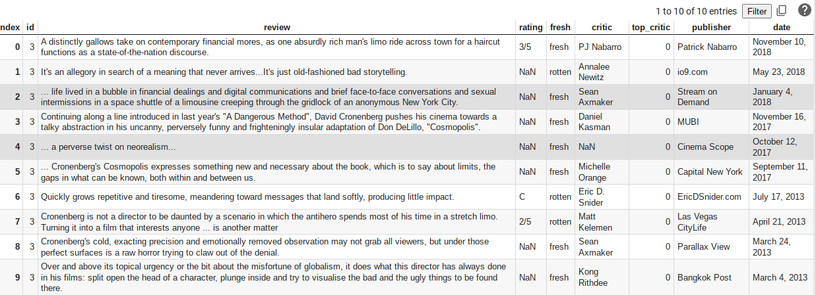
Ratings and review data set.
Below is a representation of part of the data set used to analyse the movie reviews and rating

Slide 18
Data cleaning process
Dropping missing values within a dataset.
Convert data type.
Cleaning the rating column
drop any missing raws
Graphical representation of the dataframe

Slide 19
Data analysis.
After testing the correlation between reviews and rating there was no correlation that's why we got the "NAN' output.
where 'NAN' occurs if the correlation coefficient between the 'rating' and 'review' columns is NaN, it may indicate that there is no linear relationship between these variables in the dataset.
It could also mean that the 'review' column contains missing or invalid values, which are being converted to NaN by the pd.to_numeric() function. In this case, we had dropped the missing values hence making sure the error doesn't occur

Slide 20
Business understanding
The purpose of this project was to analyse data and help Microsoft as they start on their new movie studio the best approaches to us ein order to set up the right business model.
Analysis done on the production budget , domestic sales and worldwide sales indicated there is a positive correlation between the three and the worldwide gross sales having a higher correlation than domestic sales meaning Microsoft should start producing high budget movies because of the positive correlation between production budget and movie gross sales.
Also high produced budget movies create higher rating hence mor audience coverage on the views and hence Microsoft can make high sales by investing more money on movie production.
Movie popularity and ratings have a positive correlation this means popular movies have high ratings and this is also related to high domestic sales is positively correlated with high foreign sales when there are more sales in the domestic market it tends to be the same on the international market.
Microsoft would likely work on strategies that will create more popularity in the domestic market which translate to more popularity in the world wide market.

Slide 21
Business understanding
When it comes to critics and movie ratings there is no correlation between critics and movie review because some of the critics are biased and the ratings end up being high regardless the bad review given about the movies.
It wouldn't be wise that microsoft should invest a lot of money in reviews and critics analysis because the relationship between the does not show any strong relationship between them.

Slide 22
Recommendation.
Star by planing on high budget movies with the best three selling genre being Action And adventure , comedies , science fiction, animated files and superheroes. With science fiction movies having the highest ratings an example being the mave movie studio which makes high gross sales.
Domestic sales matter as much as worldwide sales hence microsoft should invest more on both markets which will lead to a high gross sales and popularity ratings.
Targeting the local market a current strategy with netflix and showmax where within africa they have increased the african content for their views which has lead them to gain more popularity because of raising local talent

